Slide 1
Visualizing political sentiment data using machine learning techniques
By Liz Joseph
Supervisor: Dr. Mwaura
Co-Supervisor: Mr. van Heerden

Slide 2

Problem Statement
Images
Tweets
Social Media images
Polical information is comm via social media – The tool to comm opinion is usually through twitter, political wars
(How political opinions affect us , How social media has moved from newspapers/tv to online/sm and we need to gather this data online )

Slide 3
Solution
Lets put some science into this: Combine AI and big data
Can computational intelligence be used to mine and visualize big data:
Goals:
1. Mine and pre-process the data
2. Visualize and analyse the data per location in South Africa
3. Check possible outlier opinions contrary to belief

Slide 4
What is Sentiment Analysis and why is it important?
Sentiment analysis is the categorization of given text into an emotion.
Consumers can use sentiment analysis to research products or services before making a purchase. E.g. Kindle
Marketers can use this to research public opinion of their company and products, or to analyze customer satisfaction. E.g. Election Polls
Organizations can also use this to gather critical feedback about problems in newly released products. E.g. Brand Management (Nike, Adidas)
image

Slide 5

Where am I now?
1. Literature survey on existing machine learning techniques for:
Data mining
Data visualisation
2. Case study on the SOM algorithm.
3. Pre-process twitter data.

Slide 6
Related Work
Detecting small clusters by Joao and Lobo
The importance of data preprocessing for the purpose of identifying clusters
Detection prolongs computation time and the SOM needs to be further assessed.
Classification Techniques
Positive and negative classification by Bo Pang(NB, MEC, SVM)
They were more effective in topic-based categorization than sentiment classification
I performed sentiment analysis using these classification techniques (NB, MEC)

Slide 7
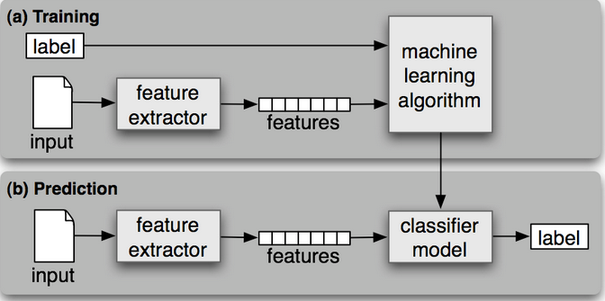
Classifiers
Notes:
Feature vector is the most important concept in implementing a classifier.
A good feature vector directly determines how successful your classifier will be.
The feature vector is used to build a model which the classifier learns from the training data and further can be used to classify previously unseen data.
To explain this, I will take a simple example of “babies
Similarly, in tweets, we can use the presence/absence of words that appear in tweet as features.
In the training data, consisting of positive, negative and neutral tweets, we can split each tweet into words and add each word to the feature vector.
Some of the words might not have any say in indicating the sentiment of a tweet and hence we can filter them out.
Adding individual (single) words to the feature vector is referred to as 'unigrams' approach.
Some of the other feature vectors also add 'bi-grams' in combination with 'unigrams'. For example, 'not good' (bigram) completely changes the sentiment compared to adding 'not' and 'good' individually.
Here, for simplicity, we will only consider the unigrams. Before adding the words to the feature vector, we need to preprocess them in order to filter, otherwise, the feature vector will explode

Slide 8
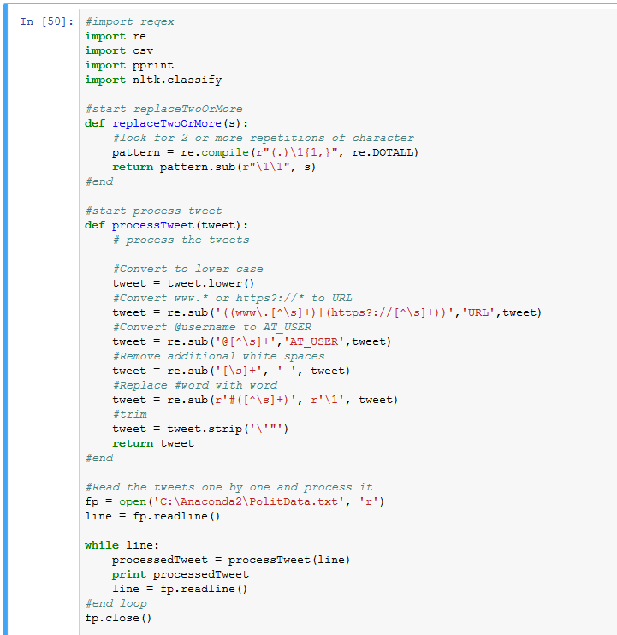

Experiment One (Naïve Bayes Classifier)

Slide 9
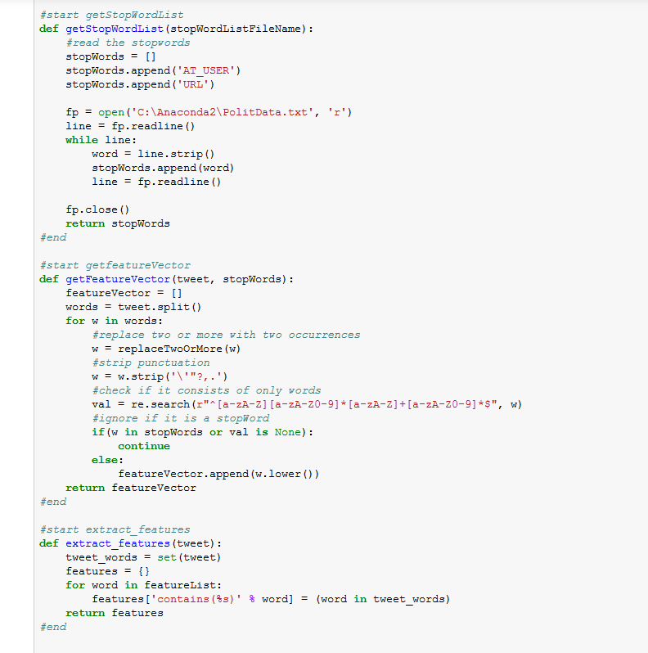
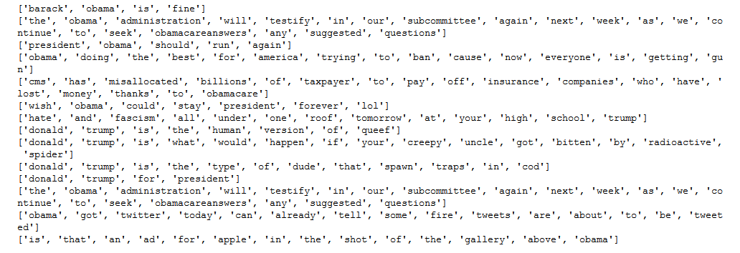
Feature Vector
Notes:
Filtering tweet words (for feature vector)
Stop words - a, is, the, with etc. From an online stop words dictionary. These words don't indicate any sentiment and can be removed.
Repeating letters - if you look at the tweets, sometimes people repeat letters to stress the emotion. E.g. hunggrryyy, huuuuuuungry for 'hungry'. We can look for 2 or more repetitive letters in words and replace them by 2 of the same.
Punctuation - we can remove punctuation such as comma, single/double quote, question marks at the start and end of each word. E.g. beautiful!!!!!! replaced with beautiful
Words must start with an alphabet - For simplicity sake, we can remove all those words which don't start with an alphabet. E.g. 15th, 5.34am
For each tweet, if a feature word is present, we mark it as 1, else marked as 0. Instead of using presence/absence of feature word, you may also use the count of it, but since tweets are just 140 chars, I use 0/1. Now, you can think of each tweet as a bunch of 1s and 0s and based on this pattern, a tweet is labeled as positive, neutral or negative.

Slide 10
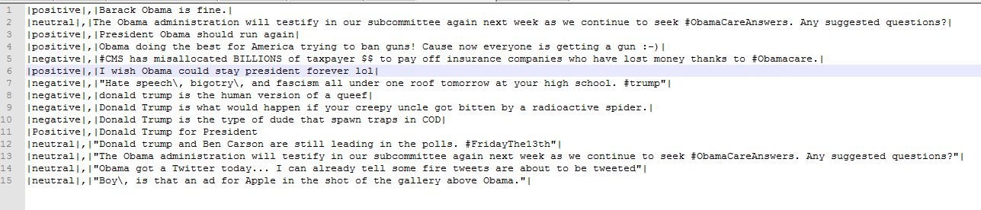
Training data
Manually classify tweets into positive or negative

Slide 11
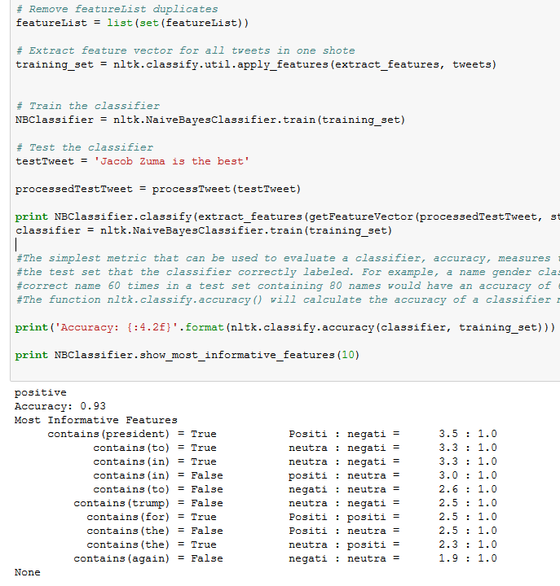
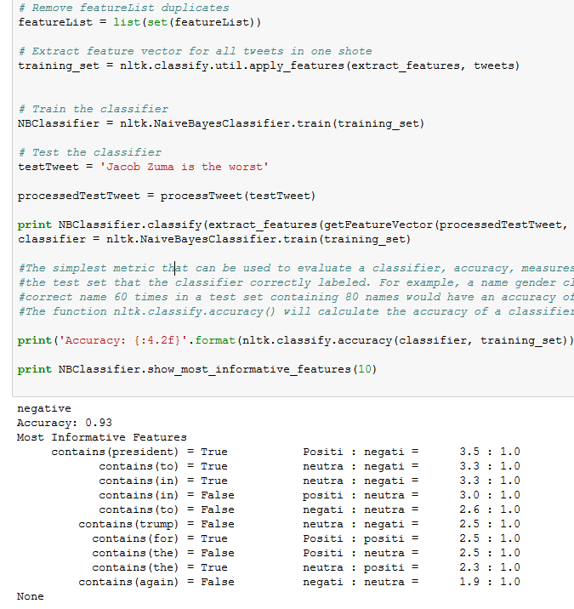
Result of Naïve Bayes
Notes:
Step 1: Convert the data set into a frequency table
Step 2: Create Likelihood table by finding the probabilities like Overcast probability = 0.29 and probability of playing is 0.64.
Step 3: Now, use Naive Bayesian equation to calculate the posterior probability for each class. The class with the highest posterior probability is the outcome of prediction.
If categorical variable has a category (in test data set), which was not observed in training data set, then model will assign a 0 (zero) probability and will be unable to make a prediction.
This is often known as “Zero Frequency”. To solve this, we can use the smoothing technique.
One of the simplest smoothing techniques is called Laplace estimation.
On the other side naive Bayes is also known as a bad estimator, so the probability outputs from predict_proba are not to be taken too seriously.

Slide 12
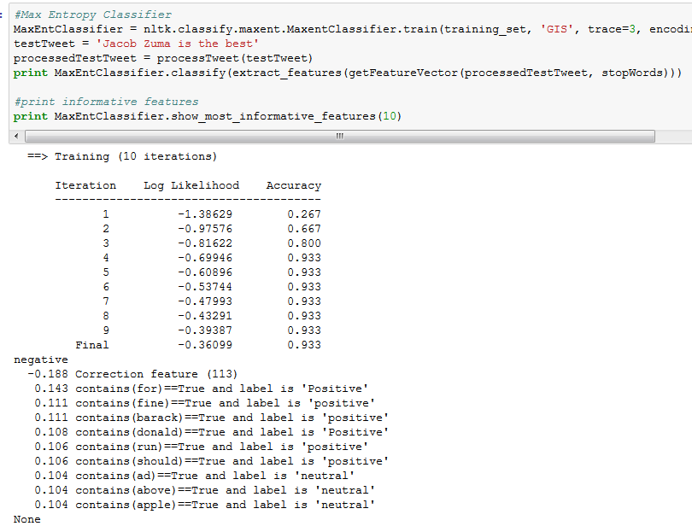
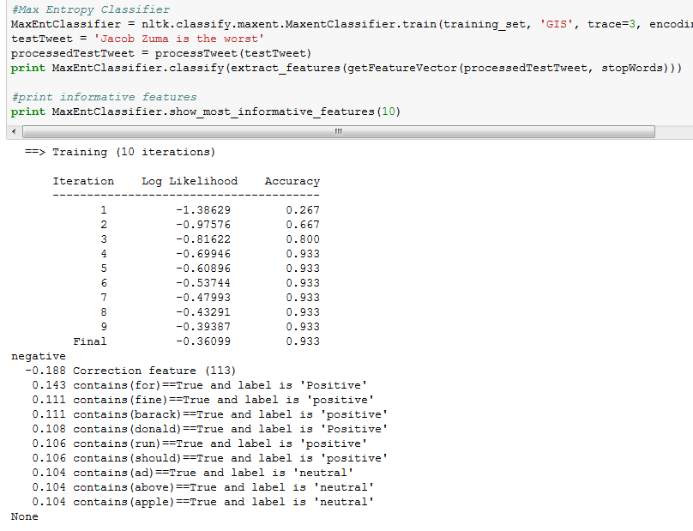
Experiment Two (Maximum Entropy Classifier)
Notes:
MEC – is a probability classifier which performs well in sentiment analysis
Unlike Naïve Bayes it doesn’t assume the feature are independent of each other.
Based on all the models that fit the training data it selects the one with the largest entropy
Requires more time to train than the Bayes classification technique.

Slide 13
Where next?
Use SOM_PAK empirically to generate maps and clusters.
Critical analysis of SOM algorithm and propose a way to improve it.

Slide 14
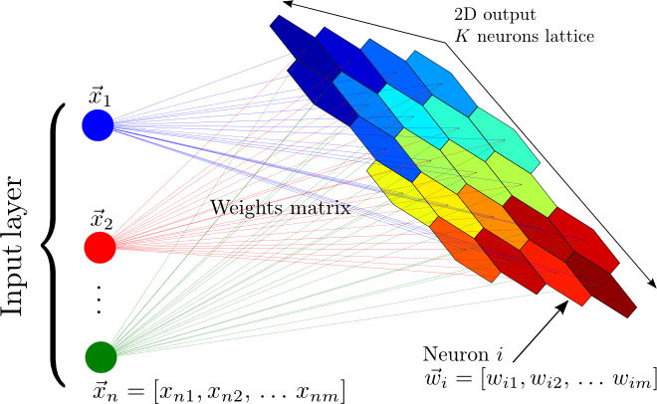
Self-organizing maps (SOM) algorithm
The Self-organizing map is an unsupervised competitive algorithm.
It made up of a vector of nodes for input ,an array of nodes as an output map, and a matrix of connections between each output layer.
How- Input nodes receive vectorized input data patterns
Propagate them to a set of output nodes.
Kohenens principle of topographic map
Notes:
The Self-organizing map is an unsupervised competitive algorithm.
It made up of a vector of nodes for input ,an array of nodes as an output map, and a matrix of connections between each output layer.
How- Input nodes receive vectorized input data patterns and propagate them to a set of output nodes.
Kohenens principle of topographic map formation determines the location of the output nodes on the map corr. to a feature in the input data pattern.

Slide 15

Self-organizing maps (SOM) algorithm
The SOM learning algorithm will be used in this manner:
Step 1. Initialize weights of neurons in map.
Step 2. Randomly select a training vector xi from the corpus.
Step 3. Determine the neuron c, having the highest activity level with respect to xi.
Notes:
Fig. 1. ESOM of Vectors with 100 Features
The experimental results on the online reviews
This work has adopted classification accuracy, precision, recall and F1 Score to evaluate the performance of sentiment classification.
The movie review data set show that SOMs are well suited for sentiment based classification and sentiment polarity visualization.
The activity level of a neuron is represented by the Euclidean distance between the input pattern and that neuron’s weight vector. The neuron having the highest activity level is referred as best matching unit (BMU). Hence, the selection of BMU may be written as: formula above
The operator denotes Euclidean vector norm as the neuron j with synaptic weights wj is closest to xi. The discrete time notation t denotes the current training iteration. 

Slide 16
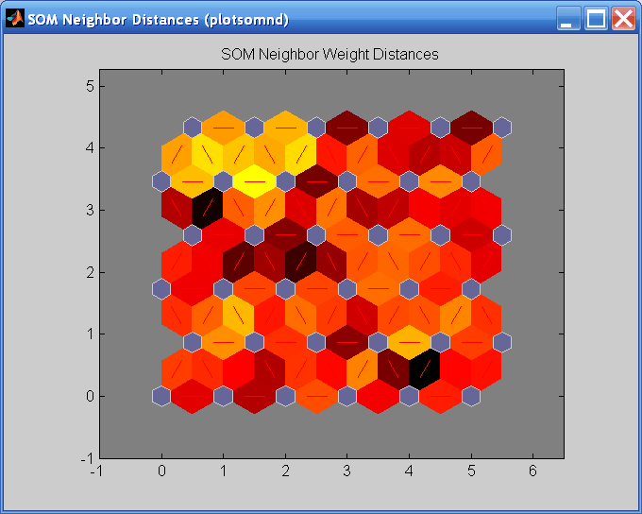

Self-organizing maps (SOM) algorithm
The SOM learning algorithm will be used in this manner:
Step 4. Update the synaptic weights of the BMU and its neighbors in order to move the BMU closer to the input vector.
Step 5. Increase time stamp t representing training iteration. If t reaches the preset maximum training time T, stop the training process; otherwise decrease α(t) (0< α(t) <1), and the neighborhood size, and go to Step 2.
Notes:
Step 4: The map adapts to the input pattern in all iterations of learning, and adaption is performed as a gradual reduction of the spatial distance between the input vector and BMU’s weight vector. The learning rate parameter α(t) controls the amount of adaptation that gradually decreases during the course of training.
Step 5: The current study has implemented SOM algorithm as a baseline model and its multi-pass implementation for sentiment analysis. The multi-pass SOM is recommended for better results where two passes are executed on the same underlying model. The first pass is executed as a rough ordering pass with large neighborhood, learning rate and small training time. The second pass is performed as the fine tuning pass that has a longer training time, small initial neighborhood and smaller initial learning rate
Advantages of using the SOM:
SOM have two advantages over other clustering methods: non-linear projection of the input space and cluster topology preservation. Thus, SOM can extract inherent non-linear relationships amongst documents, and similar clusters of documents are mapped close to each other revealing higher level (i.e. emergent structures)
Great for text clustering and visualization

Slide 17
Conclusion
I plan on comparing the accuracy of the SOM to other machine learning techniques for the classification of micro-posts.
Visualize output and convey in a meaningful manner
Using Python(primary), Twitter4J, Tweepy, SOM_Pak, Panda, Anaconda, SQLite, Sqliteman.
Data set – region is SA and 4 main political parties.

